Slide 1
AJAX
Notes:
1
1

Slide 2
Content
INTRODUCTION
WHAT IS AJAX?
TECHNOLOGIES
AJAX WORKS
AJAX - SERVER RESPONSE
ADVANTAGES
DISADVANTAGES
CONCLUSIONS
REFERENCES

Slide 3
INTRODUCTION
Ajax stands for asynchronous JavaScript and XML.
It is a group of interrelated web development techniques used on the client-side to create interactive web applications .
AJAX is about updating parts of a web page, without reloading the whole page.
Ajax uses a combination of HTML and CSS to mark up and style information .

Slide 4
WHAT IS AJAX?
Asynchronous JavaScript and XML (AJAX).
Not a stand-alone language or technology.
Combines a set of known technologies in order to create faster and more user friendly web pages.
Client side technology.
Makes web pages more responsive by exchanging small amounts of data.
Allows the web page to change its content without refreshing the whole page.
Web browser technology independent of web server software.

Slide 5
TECHNOLOGIES
HTML or XHTML and CSS for presentation
The Document Object Model for dynamic display of and interaction with data
XML for the interchange of data, and XSLT for its manipulation
The XMLHttpRequest object for asynchronous communication
JavaScript to bring these technologies together

Slide 6
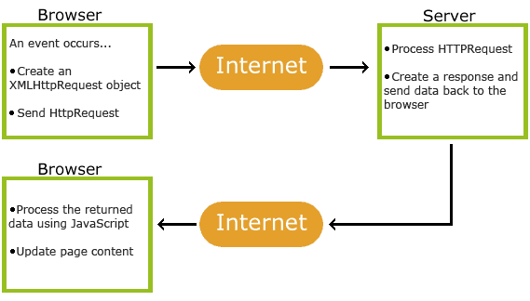
AJAX Works
AJAX allows web pages to be updated asynchronously by exchanging small amounts of data with the server without reloading the whole page.
Classic web pages,must reload the entire page if the content should change.
Examples of applications using AJAX: Google Maps, Gmail, Youtube, and Facebook tabs.

Slide 7
AJAX Example
The AJAX application contains one div section and one button.
The div section will be used to display information returned from a server.
The button specify and hold function.
The script section contains the function.

Slide 8
AJAX - Create an XMLHttpRequest Object
The XMLHttpRequest object is used to exchange data with a server behind the scenes(i,e) possible to update parts of a web page, without reloading the whole page.
Syntax for creating an XMLHttpRequest object:
xmlhttp=new XMLHttpRequest();

Slide 9
AJAX - Send a Request To a Server
METHOD | DESCIPTION | SYNTAX
open(method,url,async) | Specifies the type of request, the URL, and if the request should be handled asynchronously or not. method: the type of request: GET or POST url: the location of the file on the server async: true (asynchronous) or false (synchronous) | xmlhttp.open("GET","ajax_info.txt",true);
send(string) | Sends the request off to the server. string: Only used for POST requests | xmlhttp.send();

Slide 10
AJAX - Server Response
The responseText Property is used when the response from the server is not XML,returns the response as a string.
tTo get the response from a server, use the responseText or responseXML property.
PROPERTY | DESCRIPTION
RESPONSE TEXT | get the response data as a string
RESPONSE XML | get the response data as XML data

Slide 11
AJAX - The onreadystatechange Event
When a request is sent to server, we need to perform some actions based on the response.
Three important properties of the XMLHttpRequest object:
The onreadystatechange event is triggered every time the readyState changes.
The readyState property holds the status of the XMLHttpRequest.
status 200: "OK"

Slide 12
Using a Callback Function
A callback function is a function passed as a parameter to another function.
If you have more than one AJAX task on your website, you should create ONE standard function for creating the XMLHttpRequest object, and call this for each AJAX task.
The function call should contain the URL and what to do on onreadystatechange.

Slide 13
Example
<!DOCTYPE html>
<html>
<body>
<div id="demo">
<h1>The XMLHttpRequest Object</h1>
<button type="button" onclick="loadDoc()">Change Content</button>
</div>

Slide 14
<script>
function loadDoc()
{
var xhttp = new XMLHttpRequest();
xhttp.onreadystatechange = function()
{
if (this.readyState == 4 && this.status == 200)
{
document.getElementById("demo").innerHTML =
this.responseText;
}
};
Notes:
readyState Holds the status of the XMLHttpRequest. Changes from 0 to 4: 0: request not initialized 1: server connection established 2: request received 3: processing request 4: request finished and response is ready.

Slide 15
xhttp.open("GET", "ajax_info.txt", true);
xhttp.send();
}
</script>
</body>
</html>

Slide 16
ADVANTAGES
page can be refreshed dynamically
response of the interface to user is faster
load much faster because the payload is much smaller
reduces the demand for bandwidth
allows the web applications to be much more efficient
operate more like an application rather than a standalone program

Slide 17
DISADVANTAGES
integration of browsers
hard for the user to bookmark the state of the web page

Slide 18
CONCLUSIONS
Ajax provides functionality to create a robust web application.
If an Ajax web application is coded properly it will run faster than and as secure as a non-Ajax program.
Ajax also allows websites to reduce their overall bandwidth usage and server load by reducing the amount of full page loads.

Slide 19
REFERENCES
www.google.com
www.wikipedia.com
www.SeminarSlide.com

Slide 20
THANKS

